Slide 1
Water Potability Investigation
Abby Lavoie
M448
Spring 2023

Slide 2
Overview
Context/Importance
Data Introduction
Variables
Visualization
Data Cleaning
Comparison of Analytical Methods
Variables Selected
Classification Error
Visualization
Summary
Future Research (& Criticism)

Slide 3
Context: Importance of Water Potability
Potable
Safe for drinking, bathing, and cooking
Contaminants
Bacteria, heavy metals, organic waste & decay, agriculture runoff, etc
Drinking water
Access
Drought: global and local
Recycling water
Marketability of simple test
Prevent deaths/illness
Current tests
How accurately can potability be predicted?
What are the most important factors in predicting potability?

Slide 4
Data Set
Retrieved from Kaggle, unknown publisher
Predictor Variables: Physiochemical measurements
pH, Hardness, Solids, Chloramines, Sulfate, Conductivity, Organic Carbon, Trihalomethanes, Turbidity
Continuous, quantitative
Response Variable: Potability
Binary, Categorical
0 – Not Potable, 1 - Potable
Sample Size
n = 3276 bodies of water
Missing Data
1434 missing pieces of data (pH, Sulfate, and Trihalomethanes)
1265 observations total

Slide 5
Predictor Description & Acceptable Levels
*NTU = Nephelometric Turbidity Units
Variable | Description | Acceptable Levels | Range in Data Set
pH | Acid/Base indicator | 6.5-8.5 (WHO) | 0 – 14
Hardness | Capacity to precipitate soap, measure of salts | 60-120 mg/L (USGS) | 47.43 – 323.12
Solids | Dissolved geologic solids, produce bad taste and off color | < 300 ppm (SDWF) | 320.9 – 61,227.2
Chloramines | Byproduct of ammonia treatment | ≤ 4 ppm (CDC) | 0.352 – 13.127
Sulfate | Minerals, rocks, and soil, naturally occurring | < 250 mg/L (EPA) | 129 – 481
Conductivity | Ion concentration | < 1000 mS/cm (EPA) | 181.5 – 753.3
Organic Carbon | Decaying organic matter | < 25 ppm | 2.20 – 28.30
Trihalomethanes | Byproduct of chlorine treatment | < 80 mcg/L (EPA) | 0.738 – 124
Turbidity | Solid matter | < 5 NTU* (WHO) | 1.450 – 6.739

Slide 6
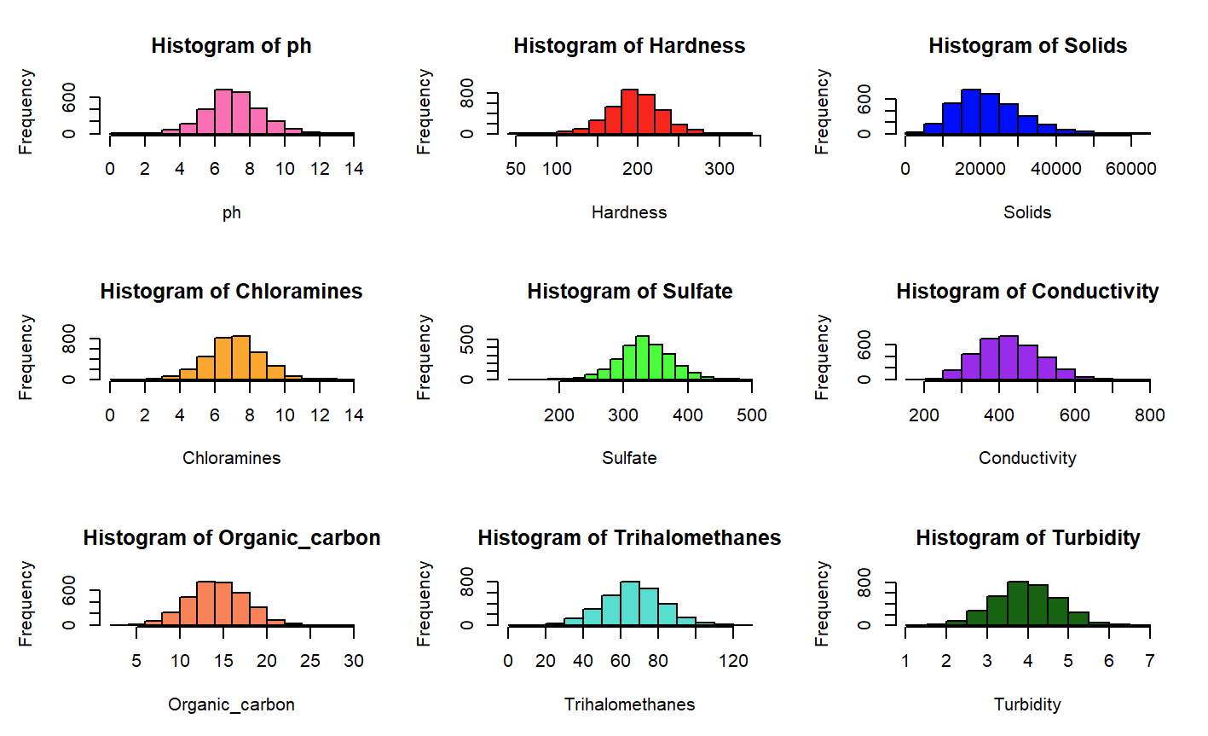
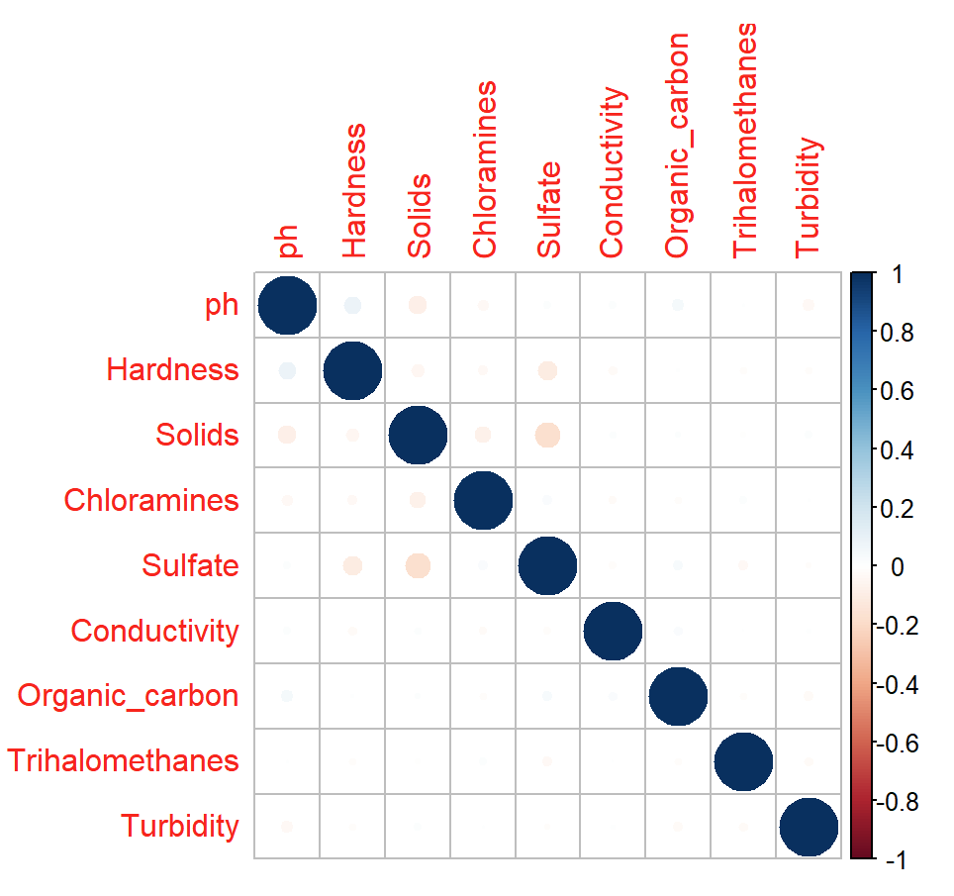
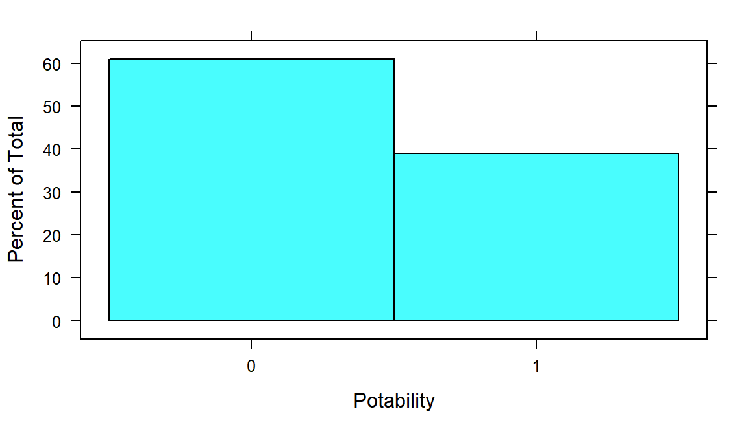

Slide 7
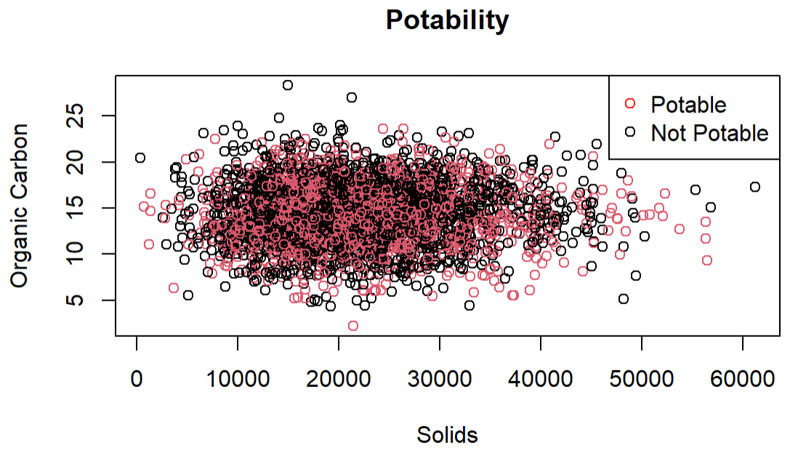
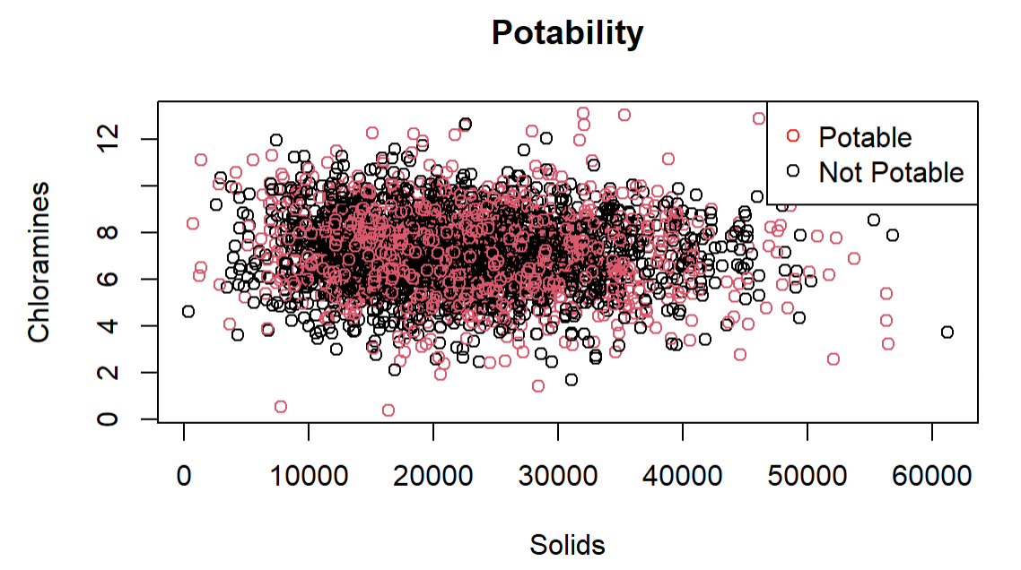

Slide 8
Data Cleaning
Missing Data
1. Delete observations with NAs
Reduced sample size by 1265 observations
2. Impute observations
Use column mean
Kept sample size same as original
Result: 2 data sets
“Omitted” or “NA” – removed NAs (n = 2011)
“Imputed” or “IMP” – changed NAs (n = 3276)
Maintained Proportion of 0’s and 1’s in response (~0.6:0.4)
Maintained Correlation Structure
Standardized all variables

Slide 9
Analytical Methods
Data Split: Training (80%) and Testing (20%)
Omitted Data set: Training (n= 1608) and Testing (n= 403)
Imputed Data set: Training (n= 2620) and Testing (n= 656)
Methods Applied:
Variable Selection – Wrapper and Embedded (also, Trees and SVM)
1. Generalized Linear Model (family=binomial, link=identity)
2. Logistic Regression
3. LDA
4. KNN
5. Trees – Classification, Bagging, and Random Forest
6. SVM – Linear, Polynomial (degree 2, 3, & 4) , and Radial

Slide 10
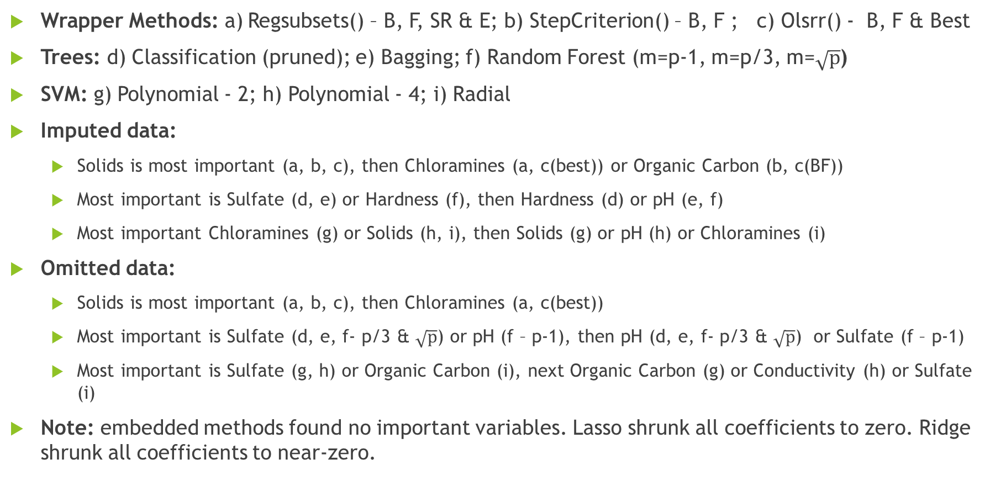
Variable Selection
Wrapper Methods: a) Regsubsets() – B, F, SR & E; b) StepCriterion() – B, F ; c) Olsrr() - B, F & Best
Trees: d) Classification (pruned); e) Bagging; f) Random Forest (m=p-1, m=p/3, m=$\sqrt{p}$)
SVM: g) Polynomial - 2; h) Polynomial - 4; i) Radial
Imputed data:
Solids is most important (a, b, c), then Chloramines (a, c(best)) or Organic Carbon (b, c(BF))
Most important is Sulfate (d, e) or Hardness (f), then Hardness (d) or pH (e, f)
Most important Chloramines (g) or Solids (h, i), then Solids (g) or pH (h) or Chloramines (i)
Omitted data:
Solids is most important (a, b, c), then Chloramines (a, c(best))
Most important is Sulfate (d, e, f- p/3 & $\sqrt{p}$) or pH (f – p-1), then pH (d, e, f- p/3 & $\sqrt{p}$) or Sulfate (f – p-1)
Most important is Sulfate (g, h) or Organic Carbon (i), next Organic Carbon (g) or Conductivity (h) or Sulfate (i)
Note: embedded methods found no important variables. Lasso shrunk all coefficients to zero. Ridge shrunk all coefficients to near-zero.

Slide 11
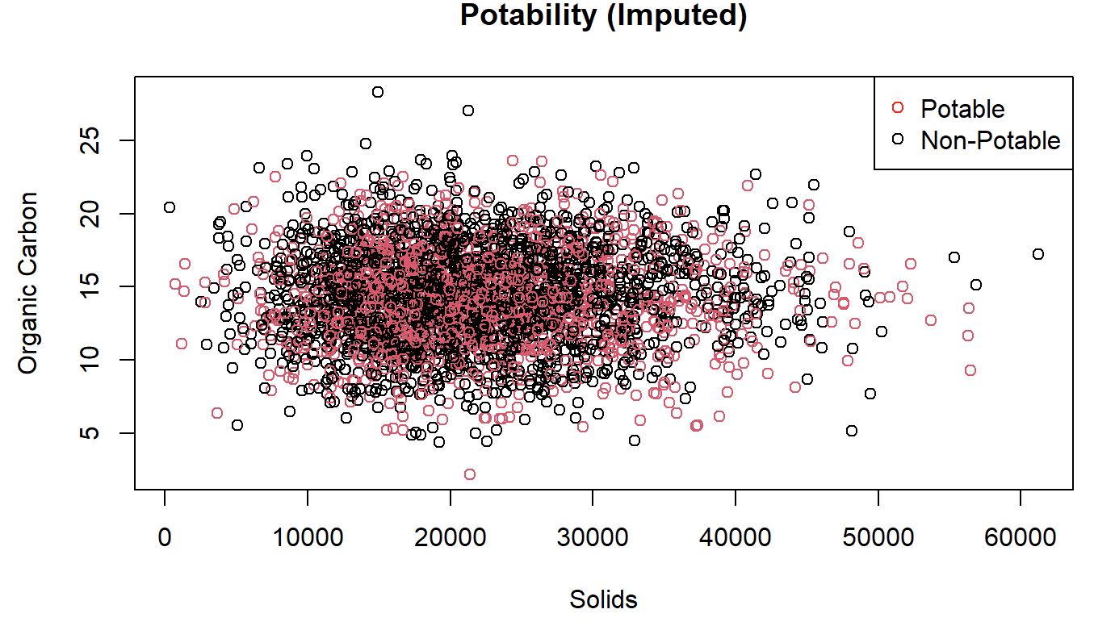
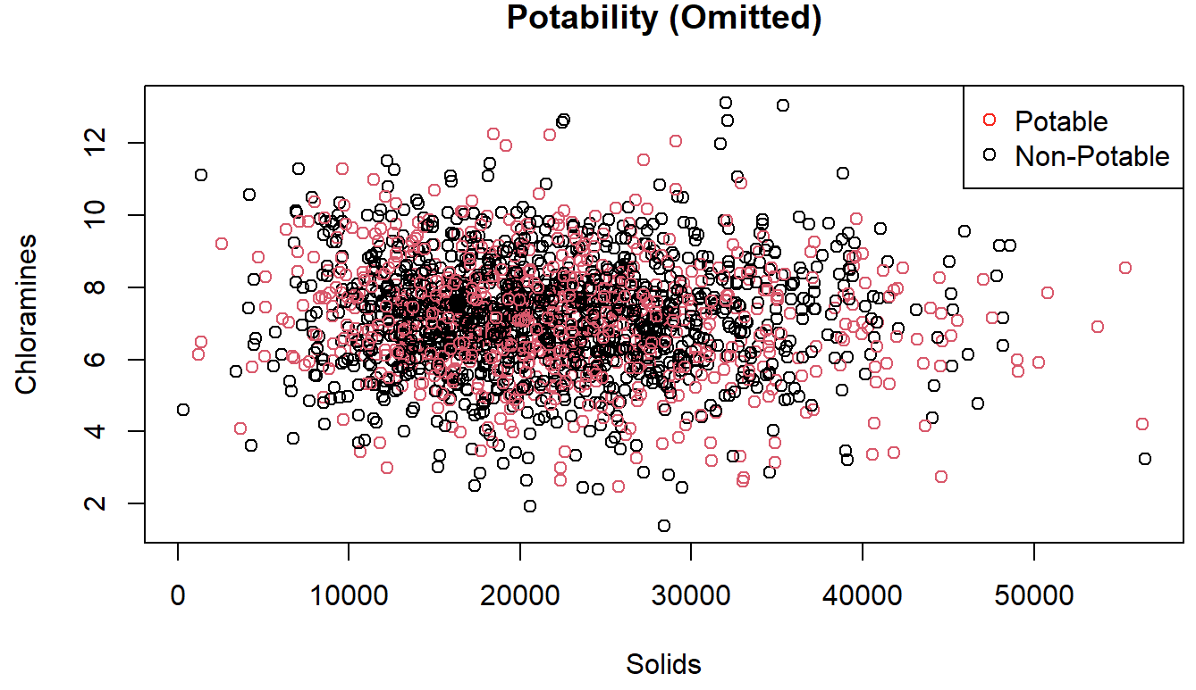
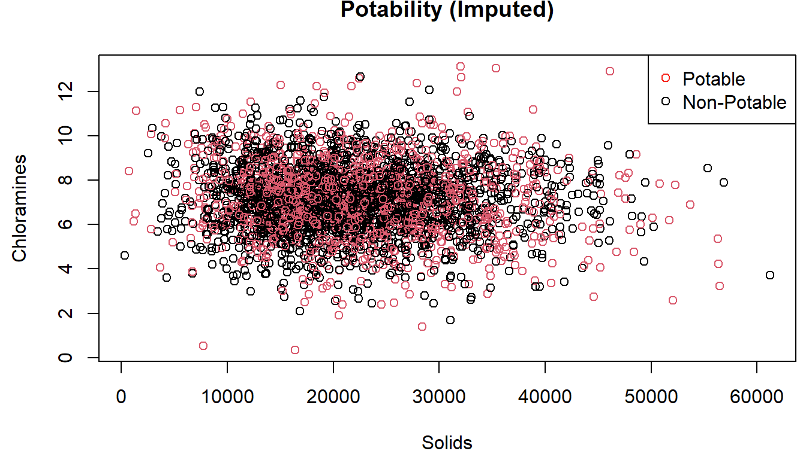
Variable Selection: Wrapper Results

Slide 12
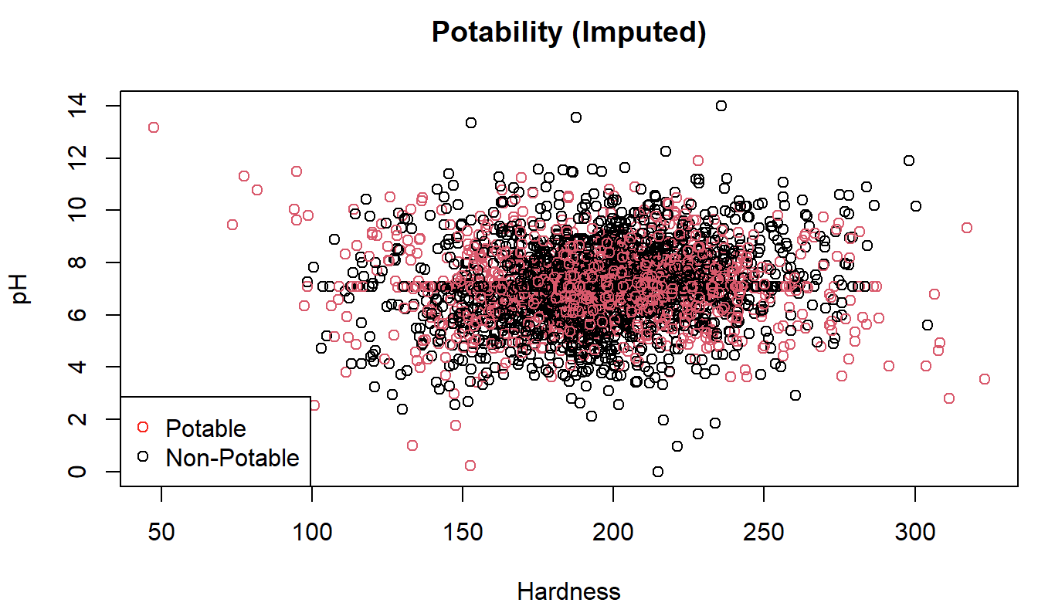
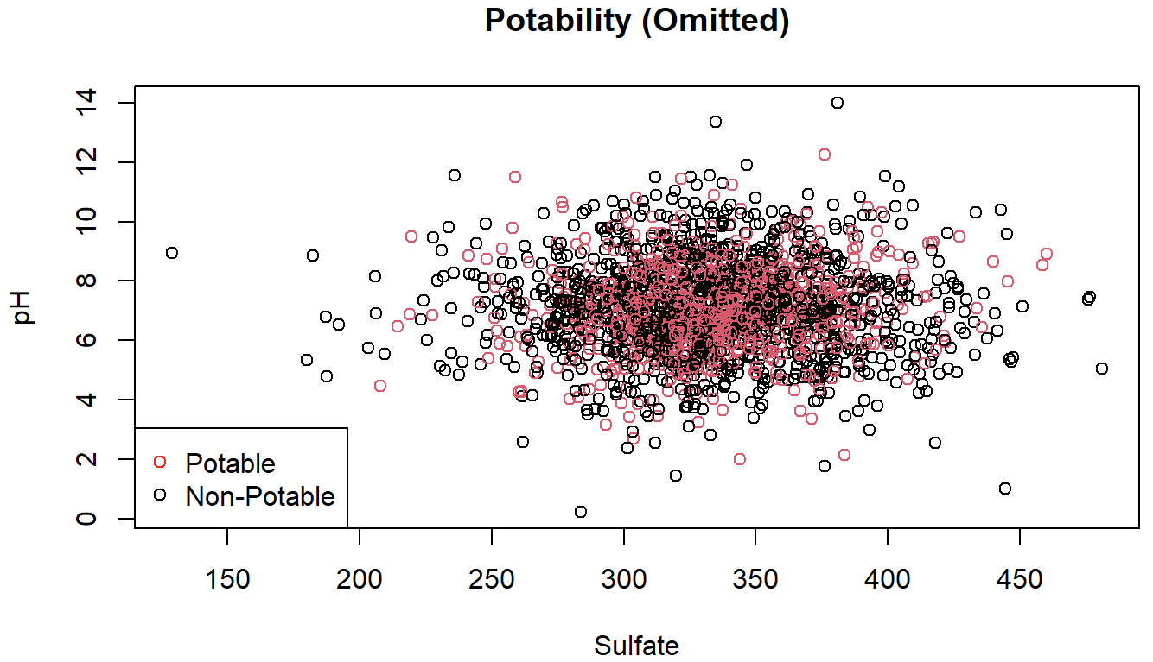
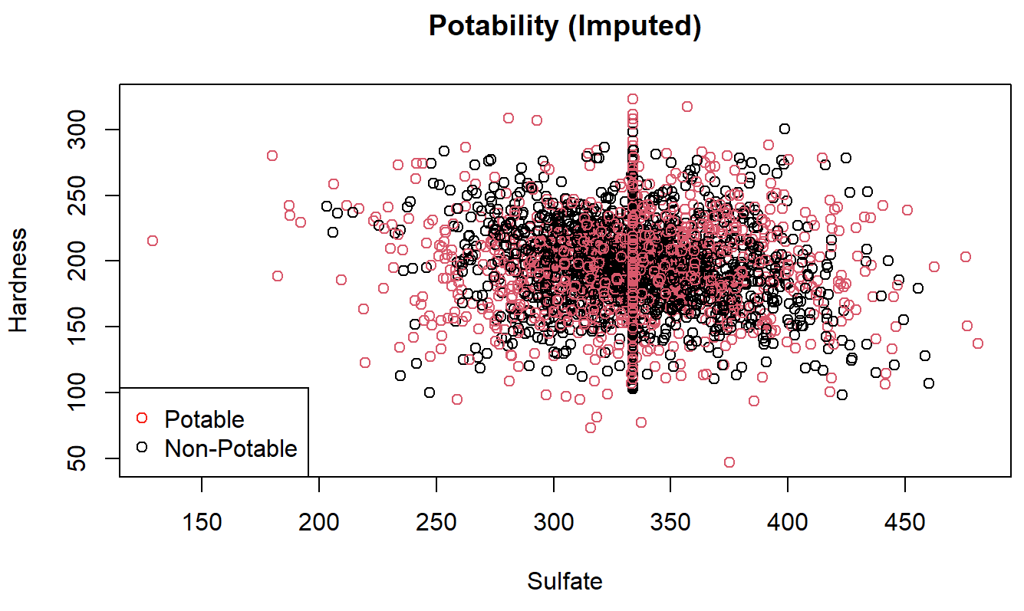
Variable Selection: Tree Results

Slide 13
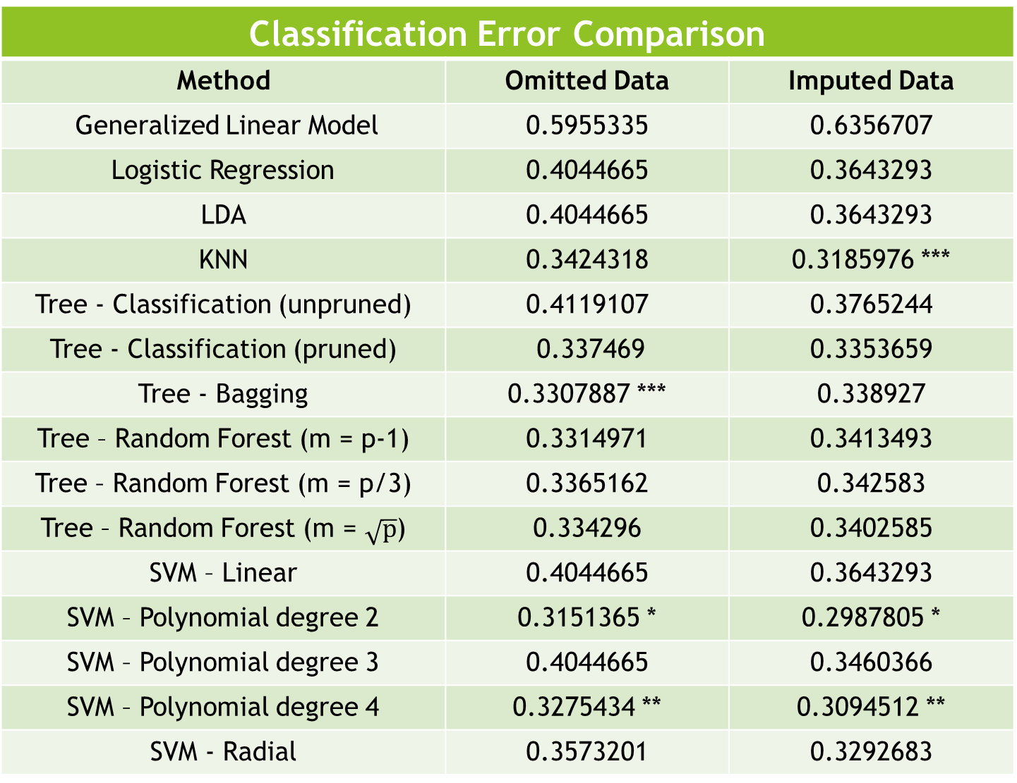
Classification Error Comparison
Method | Omitted Data | Imputed Data
Generalized Linear Model | 0.5955335 | 0.6356707
Logistic Regression | 0.4044665 | 0.3643293
LDA | 0.4044665 | 0.3643293
KNN | 0.3424318 | 0.3185976 ***
Tree - Classification (unpruned) | 0.4119107 | 0.3765244
Tree - Classification (pruned) | 0.337469 | 0.3353659
Tree - Bagging | 0.3307887 *** | 0.338927
Tree – Random Forest (m = p-1) | 0.3314971 | 0.3413493
Tree – Random Forest (m = p/3) | 0.3365162 | 0.342583
Tree – Random Forest (m = $\sqrt{p}$) | 0.334296 | 0.3402585
SVM – Linear | 0.4044665 | 0.3643293
SVM – Polynomial degree 2 | 0.3151365 * | 0.2987805 *
SVM – Polynomial degree 3 | 0.4044665 | 0.3460366
SVM – Polynomial degree 4 | 0.3275434 ** | 0.3094512 **
SVM - Radial | 0.3573201 | 0.3292683
* = Lowest Error
** = Second Lowest
*** = Third Lowest

Slide 14
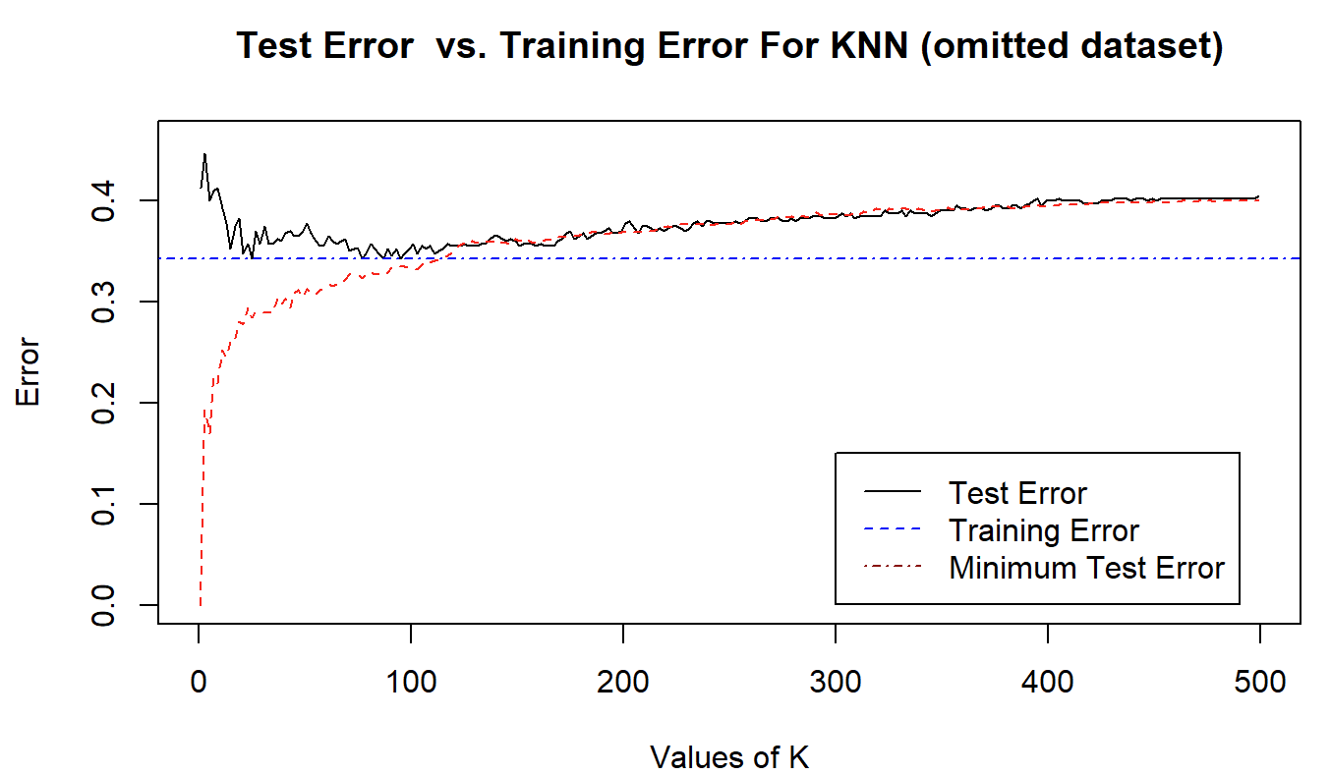
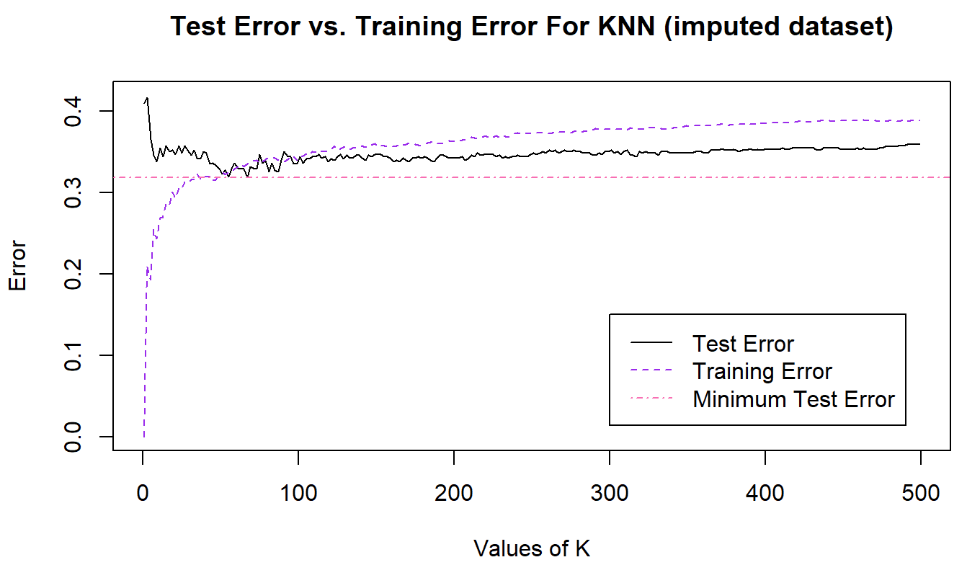
4. KNN
Minimum Error: 0.3185976 (Imputed) for K=67
0.3424318 (Omitted) for K=25, 77, 87, and 95

Slide 15
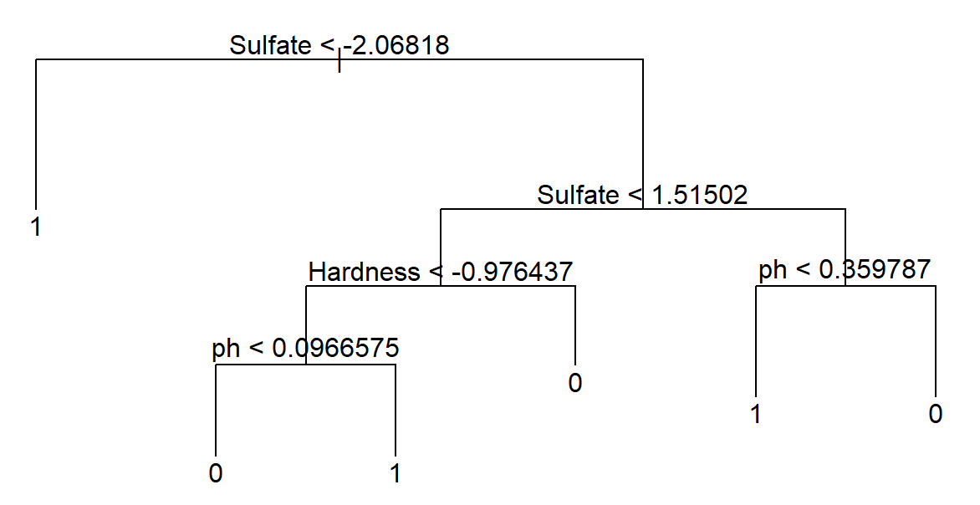
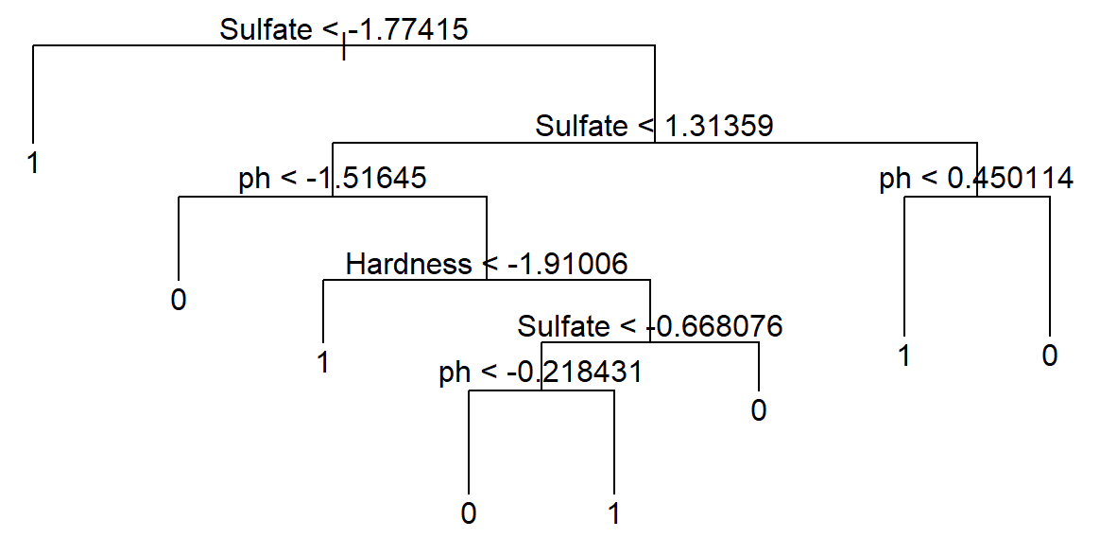
5. Trees: Best Pruned Classification Tree
Imputed
Omitted
Minimum Error: 0.3353659 (Imputed)
0.337469 (Omitted)

Slide 16
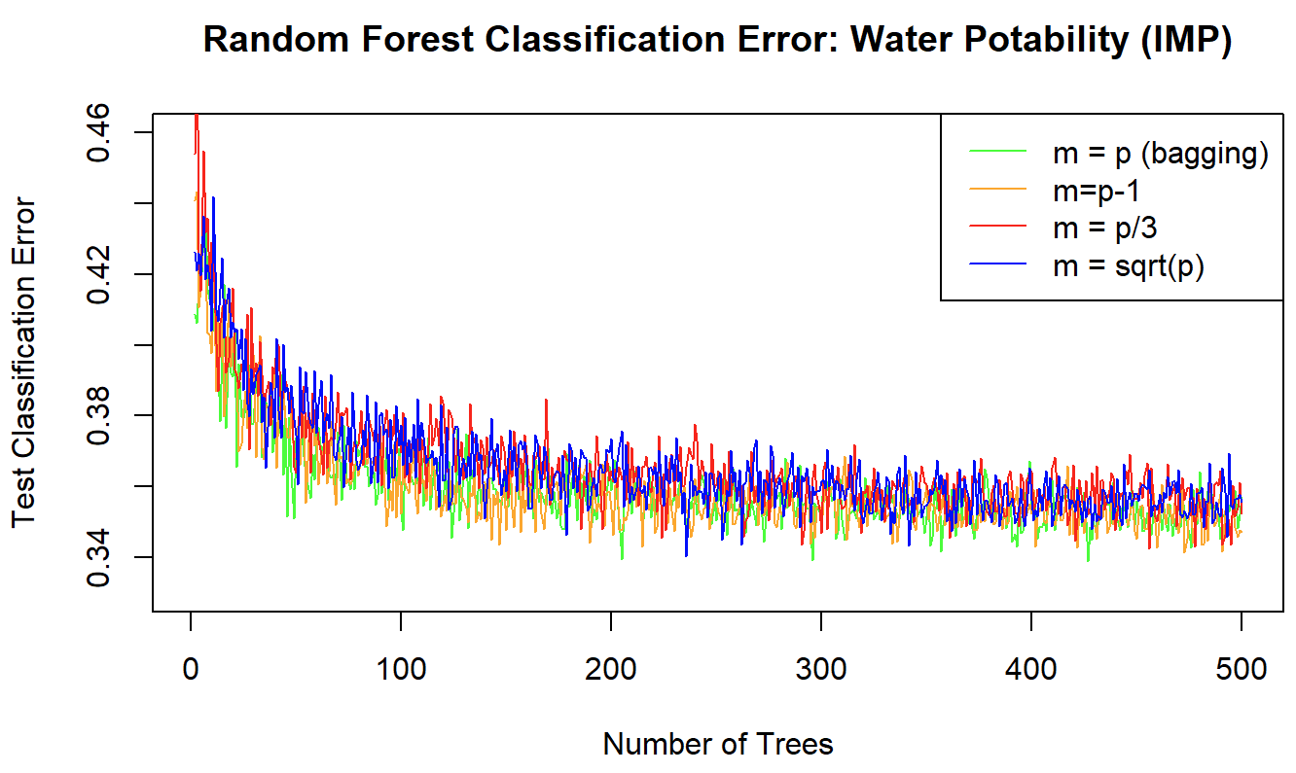
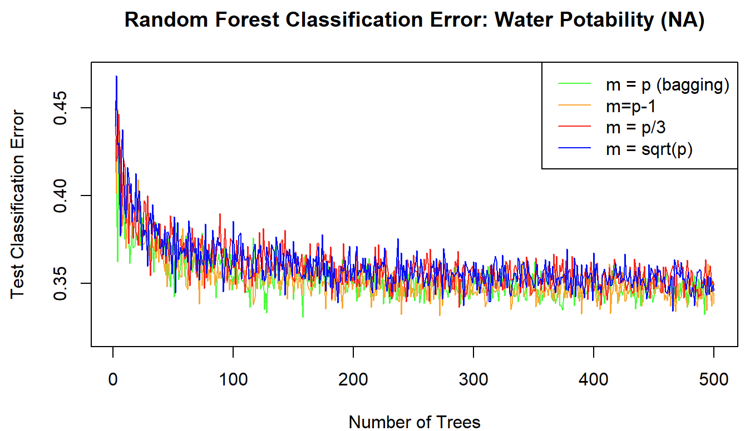
5. Trees: Random Forest Comparison
Minimum Error: 0.338927 (Imputed) for m=p for Number of Trees = 426
0.3307887 (Omitted) for m=p for Number of Trees = 157

Slide 17
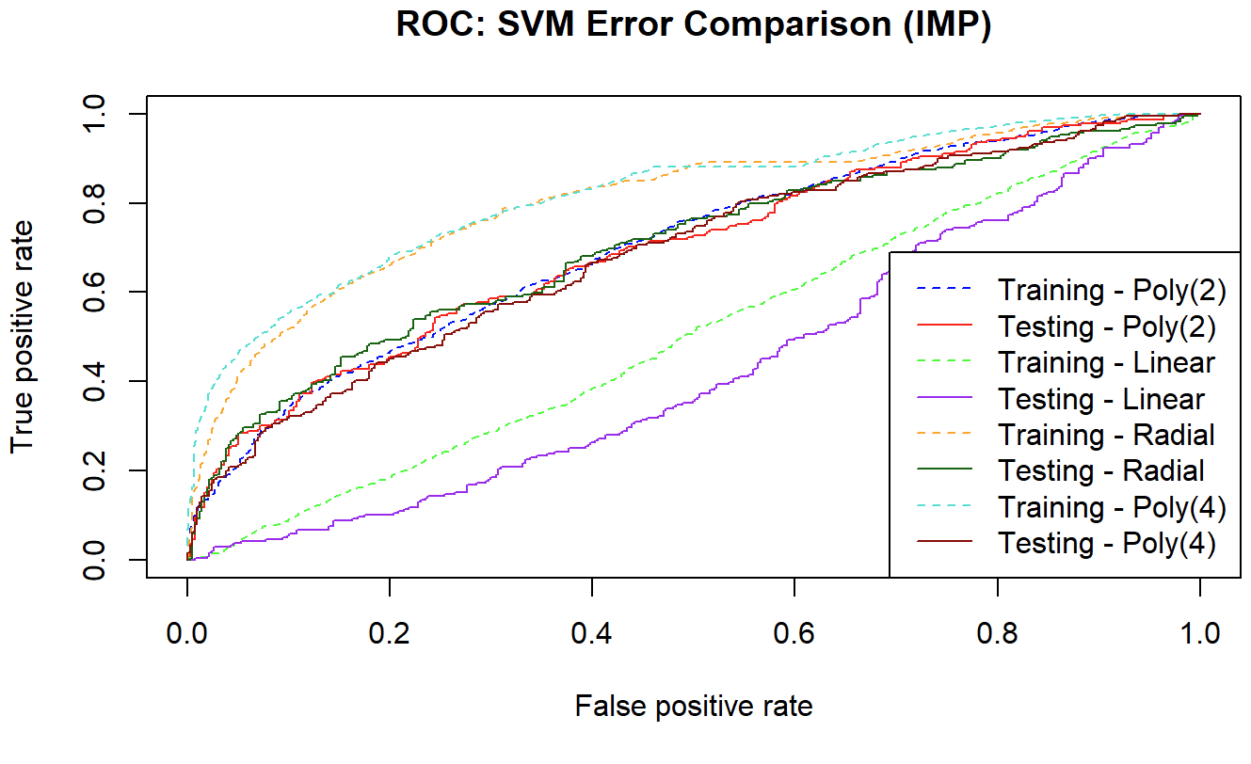
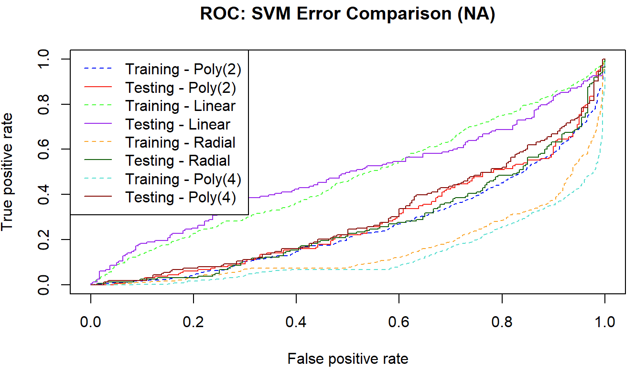
6. SVM: ROC Curves
Minimum Error: Polynomial(2) - 0.2987805 (Imputed) 0.3151365 (Omitted)

Slide 18
Summary
Best: SVM Polynomial degree 2
Minimum Test Error for both data sets
Worst: Linear Regression
Highest Test Error for both data sets
Decision boundary far from the data, predicted all to one class (potable)
Most important variable (wrapper methods)
Solids chosen for both data sets
Test error generally smaller for Imputed data set
Difficult to separate the classes
Not linearly separable

Slide 19
Future Research
Find real-world data set
Current data set is questionable
Unrealistic ranges for variables like pH
“Potable” observations not all reasonably labeled
In fact, all observations should be “Non-Potable”
pH = 0.22 labeled as “Potable”
Predictors were normally distributed
pH and Hardness were not correlated
Did not include coliform bacteria or heavy metal measures
Evaluate current water-quality home-test results
Look for more than just physiochemical predictors
Ex. Body of water location, estimated volume, and distance from pollutants
Type of waterway, usage, microbiota, plants, etc.
Apply polynomial and step functions
Use Neural Net

Slide 20
References
CDC. Available from https://www.cdc.gov/healthywater/drinking/public/water_disinfection.html#:~:text=What%20are%20safe%20levels%20of%20chloramine%20in%20water%3F,effects%20are%20unlikely%20to%20occur
EPA. Available from https://archive.epa.gov/water/archive/web/html/sulfate.html
EPA. Available from https://www.epa.gov/ground-water-and-drinking-water/national-primary-drinking-water-regulations#Disinfectants
James G, Witten D, Hastie T, & Tibshirani R. An Introduction to Statistical Learning with Applications in R. 2nd Ed. 2021. Available from https://www.statlearning.com/
Kaggle (data set). Available from https://www.kaggle.com/datasets/adityakadiwal/water-potability
Safewater. Available from https://www.safewater.org/fact-sheets-1/2017/1/23/tds-and-ph
USGS. Available from https://www.usgs.gov/special-topics/water-science-school/science/hardness-water#:~:text=General%20guidelines%20for%20classification%20of,Some%20content%20may%20have%20restrictions
World Vision. Available from https://www.worldvision.org/clean-water-news-stories/10-worst-countries-access-clean-water

